Slide 1


What’s New For TRTA Members
Presented by:
D’Anna Baucom
AMBA
Notes:
FOR FACILITATORS – Prepare for your seminar
Your goal
Seminar selling is designed as a marketing tool for you to be of service and to show your expertise. The goal of this seminar is two-fold:
To EDUCATE the audience on a concept important to their financial wellbeing. True education offers great tips and knowledge to take away.
To IDENTIFY PROSPECTS who will benefit from the various products offered, so that you follow up with them.
Seminar selling is a “soft sell.” If you do it right—tell a story, provide useful information, and provide a compelling take-away idea—you’ll have several prospects by the end of your brief presentation.
Materials list
Obtain a copy of the file amba_seminar_data_sheet_and_checklist.pdf for the complete preparation checklist.
IMPORTANT: Be sure you have all applicable discount codes for the host association available to share!
Response cards
Member Benefits Document (if applicable to the host association)
Facilitator guide
Print the notes pages view of this presentation to create your Facilitator Guide.
Add your contact information to the last slide.

Slide 2


Your Passport Membership can help you
Endorsed
benefit with
exclusive
savings for
association
members!
save money every day
on the products and services you use most.
Appliances, hotels, rent cars, movie tickets, clothes and shoes, cars, groceries, dining, shopping, computers, electronics, museums, attractions, services, and more!
Notes:
The Passport program is an exclusive ASSOCIATION member benefit … if you were to sign up for Passport on your own, it would be a cost of $81 per year.
Passport can help you save money – every day – on the products and services you use most often … or just once in a while.

Slide 3


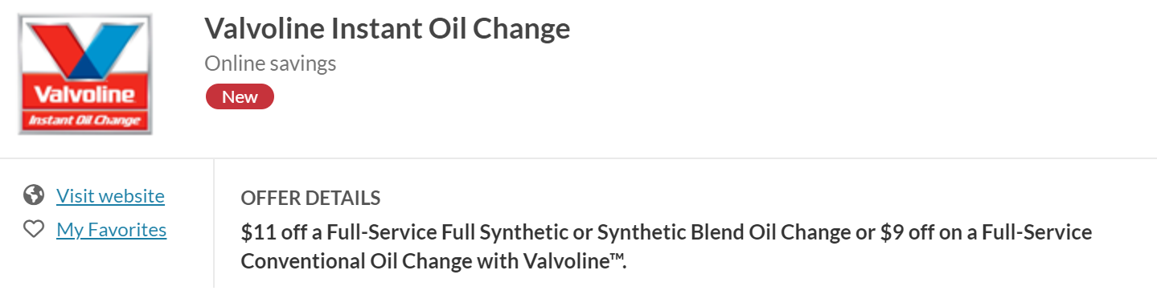

MyAMBADiscounts has saved members over $168,000 last year!
Discover the newest discounts on travel, entertainment, dining, and more!
Notes:
These are just a sample of the newest discounts you’ll find on Passport. There are always new discounts from national merchants and many local merchants as well. These discounts change frequently, so check our Passport to find what is near you.

Slide 4
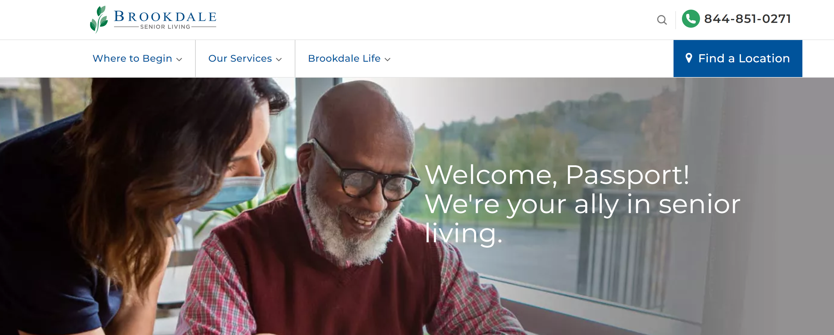

Newest Discount for Association Members
7.5% Discount on Independent Living, Assisted Living, and Memory Care Communities
10% Discount on in-home care
Short stay discounts vary by community
94 Locations in Texas
Notes:
Brand new to Passport … We often get questions about care in an Assisted Living Community or at home. Now, members have access to significant discounts through any of the over 800 Brookdale living communities across the country. There are 94 locations in Texas. This can save you $500 or more per month. Let’s talk about how you can stretch your Short Term and Long Term Care policy coverage when combined with these discounts.
Discounts through Brookdale Senior Living for Independent and Assisted Living and Memory Care Communities …
There are also discounts on in-home care and “short-stay” rates at the Brookdale communities.

Slide 5






Additional
Discount
Offerings for
Association
Members
Legal Assistance
ID/Fraud Protection
Notes:
But we also want you to be aware of several other discount offering made available to TRTA members … these may be of interest to you. Members ask us frequently for these discounted plans and now you can have access to them at group rates. Set up your benefits review and we’ll get you in contact with these providers. These range from hearing to emergency medical alert devices, ID theft and Legal Assistance for a wide variety of services you might need.
Start Hearing
Connect America Medical Alert Service

Slide 6
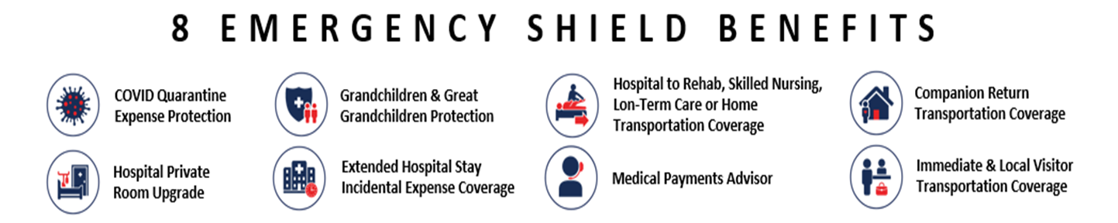
8 New MASA Benefits Now Available Through the Emergency Shield Plan
Upgrade to MASA Emergency Shield and get coverage for your minor grandchildren and great grandchildren, even if they aren’t with you!
Notes:
The MASA plan has long been a popular program with Members. You can have peace of mind for any emergency transportation need whether its across the world or just around the corner. Because of member demand, MASA has made an upgrade available that adds 8 additional benefits that can provide extra coverage for you and for you minor grandchildren and great grandchildren, even if they aren’t with you! See me afterwards for details on this plan and upgrade.

Slide 7

Proudly Presenting: TRTA Unique Journeys
TRTA Members enjoy a discounted rate on each trip!
Exclusively for TRTA
5 Incredible Trips in 2025
Coordinated with Boscov’s Travel
Learn More:
Boscovstravel.com/trta
Notes:
TRTA recently introduced the opportunity to travel with your friends and family to exciting locations all across the U.S. and the world. TRTA members enjoy a discounted rate on each trip. The three trips for 2024 have already closed for the year, but you can get a jump on the 2025 trips by registering now.

Slide 8







What’s Included in a TRTA Unique Journey?
Round Trip Air
First Class or Deluxe Hotel Accommodations
Deluxe Coach Transportation
Admissions and Sightseeing
Much More Depending Upon the Trip!
TRTA
Notes:
TRTA members enjoy fully escorted trips with great accommodations, transportation and all admissions to landmarks and museums.

Slide 9


2025 Unique Journeys – Start Planning Now
Notes:
Here are the great trips TRTA has planned in in 2025. Now is the time to find out more and join your friends on these trips.

Slide 10







Next Steps…
Roundup Your Friends & Family
Pick Your Trips
Call Boscov’s Travel at 888-606-0272
Go Online: boscovstravel.com/trta
Email for more info: TRTAuniquejourneys@boscovstravel.com
Pack Your Bags for Adventure!
Notes:
You can get more information by calling Boscov’s Travel or going to the TRTA travel website. You can even email for more information on each trip. Get a group together and go!

Slide 11
TRS-Care changes to consider whether you are over or under age 65
Compare and find out what’s best for you!
1
What are your deductibles and MOOPs?
TRS Care has different deductibles and Maximum Out of Pocket expenses than traditional Medicare and some other Med Advantage Plans.
2
What are your ongoing costs?
What are your co-pays for preventative care, specialists, emergency room visits, virtual visits, hospital stays, and prescription medications?
3
What type of flexibility do I have?
Are my doctors included? Am I locked into one plan for a whole year? Can I change when I want to? How does my plan fit my lifestyle and health issues?
Notes:
Now let’s briefly discuss the TRS-Care changes that were announced around the rates going down for the Medicare Advantage Plans. Because everyone’s personal situation is different, I would encourage you to talk to me and see what changed. We can explore the deductibles and the Maximum Out Of Pocket Expenses that could impact you. We can discuss what is and isn’t covered if you have a hospital stay and we can discuss if flexibility is important to you. Again, TRTA supports TRS-Care and at AMBA, we want you to know how it could work personally for you.

Slide 12

Endorsed
benefit with
exclusive
savings for
association
members!
TRTA Dental & Vision
Unique Value & Features to support your
Health & Savings
With top carriers, plan design, and service
Notes:
.Now, let’s briefly touch on Dental and Vision in light of the TRS announcement that they were going to be offering plans for TRS participants this coming year.
Passport can help you save money – every day – on the products and services you use most often … or just once in a while.

Slide 13
With new dental options through TRS, members are asking about the exceptional value provided by their TRTA programs!
1
TRTA Has Been Offering Valuable DV Coverage for 20 Years!
With feedback from members over 20 years, the DV Program with TRTA has evolved provide strong benefits for retired educators.
2
Tens of thousands of members trust TRTA and AMBA with their coverage.
Highlights include larger network, dental rewards rollover, freedom to choose your dentist, enrollment flexibility, high and low plan options, self service online portal, helpful call center service, and more!
3
New Options from TRS for DV Coverage leads to questions from members.
What happens to my dental rewards? If I change plans could that affect my coverage? What other benefit improvements is TRTA looking to add? What differentiates my TRTA plan and makes it a great choice?
Notes:
For over 2 decades, TRTA and AMBA have been offering great Dental and Vision Coverage options for members of the association. Large networks, flexibility and freedom to choose whatever dentist you want, multiple plans to chose from and the great rewards rollover program are many features in the TRTA/AMBA plan that you can count on. Don’t take a chance on losing those options.

Slide 14

Dental Plan Comparison | 1 of 2
TRTA offers members the richest benefit plan (TRTA Platinum) while also offering the lowest cost option (TRTA Gold).
Category | TRTA Platinum Dental | TRTA Gold Dental | TRS Dental
Summary | Richest benefit plan with superior rollover, network, and out of network benefits | Lowest cost option but still maintains good benefit value | New plan with rates higher than TRTA Gold for comparable benefits
Rates | $59.81 for member | $39.51 for member | $41.64 for individual retiree
Flexibility | Ability to add spouse, dependents, and make mid-year adjustments | Ability to add spouse, dependents, and make mid-year adjustments | Our understanding is you must enroll with no changes for full year
Freedom of Choice | Go to any dentist or save additional money in network | Go to any dentist or save additional money in network | May pay more out of pocket when going out of network
Network Size | Ameritas network has over 10,000 providers in TX | Ameritas network has over 10,000 providers in TX | Metlife network has ~7,000 providers in TX
Maximum Benefit | $2,750 ($1,500 annual maximum + $1,250 of possible rollover) | $2,000 ($1,000 annual maximum plus $1,000 of possible rollover) | $2,000 ($1,500 annual maximum + $500 maximum benefit increase)
Comparisons done with available information. Each member should review impacts to their coverage.
Notes:
Hers’s a quick comparison between the TRTA Platinum and Gold Plans and the TRS plan coming next year. Pay close attention to the levels of coverage, size of network and the flexibility you receive with each plan option.

Slide 15
Plan Comparison | 2 of 2
TRTA offers members the richest benefit plan (TRTA Platinum) while also offering the lowest cost option (TRTA Gold).
Category | TRTA Platinum Dental | TRTA Gold Dental | TRS Dental
Out of Network Benefits | High Usual & Customary benefits means strong benefits in or out of network | High Usual & Customary benefits means strong benefits in or out of network | Maximum Allowable Charge (MAC) means you may pay more out of pocket when going out of network
Enrollment & Modify Window | Anytime | Anytime | Once per year
Coinsurance Rates | 100/80/50 Plan 100% Preventative; 80% Basic; 50% Major | 100/90*/50 Plan 100% Preventative; Basic starts at 70% but moves up annually to 90% in year 3; 50% Major | 100/70/50 Plan 100% Preventative, 70% Basic, 50% Major
Other Comparison Features | Easier rollover by only needing to file one claim and spend less then $750 in annual benefits. Better out of network payment rate Improved frequencies and limitations for crowns & root canals | Basic services covered at highest rate after 2 years (90% versus 70%) which includes fillings Easier rollover by only needing to file one claim and spend less then $500 in annual benefits. Better out of network payment rate | Lower deductible X-rays covered in preventative
Comparisons done with available information. Each member should review impacts to their coverage.
Notes:
For those of you who use your dentist who doesn’t participate in a network, pay close attention to the coinsurance rates and how maximum allowable charges work. And definitely remember the TRTA rewards feature that can give you a significant amount of rewards coverage that is easier to earn for future dental care.

Slide 16
Impacts of Switching
TRTA Members have asked about risks and impacts of switching plans
1
Loss of Dental Rewards
Many TRTA members have $1,000 or more in banked dental rewards rollover to help pay for expensive dental procedures when they occur. Leaving TRTA Endorsed coverage would mean losing those banked rollover dollars.
2
Loss of Network Provider
Our research has shown the TRTA Endorsed Plan has a larger network in Texas. Leaving TRTA Endorsed coverage for another program could mean more out of pocket payments if your dentist is not in network.
Members should check with their dentist before switching to understand possible higher out of pocket payments.
3
More out of pocket when going out of network
In TRTA, many members like to choose their own dentist even if they are out of network. The TRTA Endorsed Program was designed to pay strong out of network benefits to limit your out- of-pocket payments. Our early understanding of the Metlife plan through TRS is that members may have more out of pocket payments by going out of network.
Notes:
Anytime a new plan is offered, you need to think about how that could impact you- would you lose your rewards you’ve built up? Would you lose a dentist that is not in the new network and thus could end up costing you more our of your pocket than you expected?

Slide 17
Vision Plan Comparison
VSP - the chosen provider for TRTA - has over 40,000 providers globally, is utilized by one in four Americans, and ranks highly in customer satisfaction and member support.
TRTA Plan with VSP | Now Includes $5,000 AD&D Coverage
TRS Vision Plan
Extensive network of nearly 4,000 in Texas. For vision plans, network is very important because benefits can be greatly reduced if you go out of network.
There are ~300 providers that accept the full Superior Metlife discounts. There is also a broad network of providers that accept the basic benefits but do not offer full discounts.
Network
Benefit Summary
Annual eye exam
Annual lenses covered
Frames covered every other year up to $150 which increases to $170 for featured frames.
Annual eye exam
Annual lenses covered
Frames covered every year up to $150 with additional $25 at certain providers.
Includes $5,000 Accidental Death & Dismemberment (AD&D) policy from New York Life with no health questions and no reduced benefits as members age.
TRTA Membership includes Passport Discount program at thousands of retailers and restaurants
No similar benefit enhancements
Enhanced Benefits
Rates & Copays
$12.72/mo Member Rate with $15 exam copay and $25 materials copay.
$6.89/mo Member Rate with $15 exam copay and $10 lens copay and $10 frame copay.
Comparisons done with available information. Each member should review impacts to their coverage.
Notes:
The TRTA Vision plan has one of the most robust networks in the state, which makes your vision dollars go further. And, a brand new feature, starting January 1 for all new and existing members of the plan is the addition of $5,000 in Accidental Death and Dismemberment coverage – with no age limits or medical underwriting! Starting in January, we’ll need to sit down and make sure your beneficiaries are up to date. This is a great new value-add for TRTA vision plan participants.

Slide 18
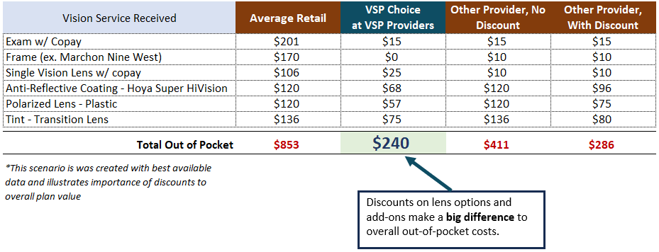
Importance of Vision Network & Discounts
Members asked TRTA and AMBA to help identify where they might have higher out of pocket costs if switching vision plans. The choice of lens enhancements is a key area.
Vision Plan value for members more than just premiums and copays - discounts on lens options reduce out of pocket costs!
Outside of progressive lenses, anti-reflective coating is a top benefit and the VSP discount can save members $50-$60 over retail prices.
Other popular lens enhancements include scratch resistance, transition lenses, blue light blockers, ultraviolet light protection, and more. Adding two to three options can lead to significant savings with VSP’s discounts.
If considering a switch from the TRTA plan through VSP, ensure that your new eyecare provider is in the network AND they agree to the discounts from that new coverage provider.
Sample Claim
Discounts make a big difference for out-of-pocket costs
Comparisons done with available information. Each member should review impacts to their coverage.

Slide 19
Key Takeaways
Members asked TRTA and AMBA to help identify where they might have higher out of pocket costs if switching vision plans. The choice of lens enhancements is a key area of education.
Dental
Vision
1
TRTA provides both the highest benefit value plan (Platinum) and the lowest cost option (Gold)
1
Extensive network that provides discounts on lens options along with excellent exams, lenses, and frame options.
2
TRTA plans are designed to pay excellent benefits in and out of network
2
Addition of $5,000 Accidental Death & Dismemberment (AD&D) benefit from New York Life coming in January 2025 with no health questions and no reduced benefits as members age.
3
Don’t lose your rollover Dental Rewards! Many TRTA members have over $1,000 in banked rollover benefit. Leaving TRTA coverage means the member forfeits this important bank of money designed to support you when large procedures are needed in the future.
3
Discounts on lens options is a key differentiator of the TRTA program with VSP’s network. These discounts help members save hundreds of dollars on lens options.
4
Larger network means great savings and helps you get the most out of your benefits.
The TRTA endorsed program also provides enrollment flexibility, online self-service portal, and enhanced coverage levels on basic services!
The TRTA endorsed program also provides enrollment flexibility, online self-service portal, and the additional AD&D benefit.
Notes:
I know you may have lots of personal questions about the TRTA Dental and Vision plans. I’m here to help schedule a time to cover all of your TRTA benefits. But don’t forget – you have the highest benefit value Dental plan available that pays well and has a broad network. And you have dental rewards that you don’t want to lose. When it comes to Vision, the broad network and great coverage are now being enhanced with $5,000 in AD&D coverage for your family.

Slide 20
Who to Call
Dental
Vision
Add/Change Coverage or Billing Question
Call AMBA at 833-643-0264
Check Your Dental Rewards Rollover Balance
Call Ameritas, our dental company, at 888-239-3336
Claim Question
Call Ameritas, our dental company, at 888-239-3336
Find a Network Provider
Call Ameritas, our dental company, at 888-239-3336
Or go online to dentalnetwork.ameritas.com
Add/Change Coverage or Billing Question
Call AMBA at 833-643-0264
Claim Question
Call VSP, our vision company, at 800-877-7195
Find a Network Provider
Call VSP, our vision company, at 800-877-7195
Or go online to www.vsp.com/eye-doctor
Notes:
If you have questions that you want answered before we can sit down for a full benefits review, take a picture of this screen. You’ll be able to find all your answers to billing, network, claims, and rewards benefits you have.

Slide 21
Thank You
TRTA Members have an excellent Dental & Vision Program Providing Value to Members!
Excellent Value – A combination of rich benefits, extensive network, stable rates, helpful customer service, and enrollment flexibility. Network providers give significant discounts for members.
Rollover Benefits - Many TRTA members have millions of dollars banked in their Dental Rewards Rollover to help pay for expensive dental services as they arise.
Vision Benefit Enhancements - Vision Plan participants will have a $5,000 AD&D Benefit from New York Life as an enhancement to the vision program! VSP’s large network with robust discounts saves money on important lens options!
Supports TRTA – Your participation helps support the TRTA program as the association works for you on important issues around pension growth and benefits.
Hundreds of new members continue to enroll each month as they compare the value of TRTA to other options.
Notes:
Thank your for your time today to discuss the latest new benefits and opportunities for TRTA members. Additionally, thank you for allowing me to provide some clarity on your important Dental and Vision plans that support not only TRTA Members, but supports TRTA as well.

Slide 22
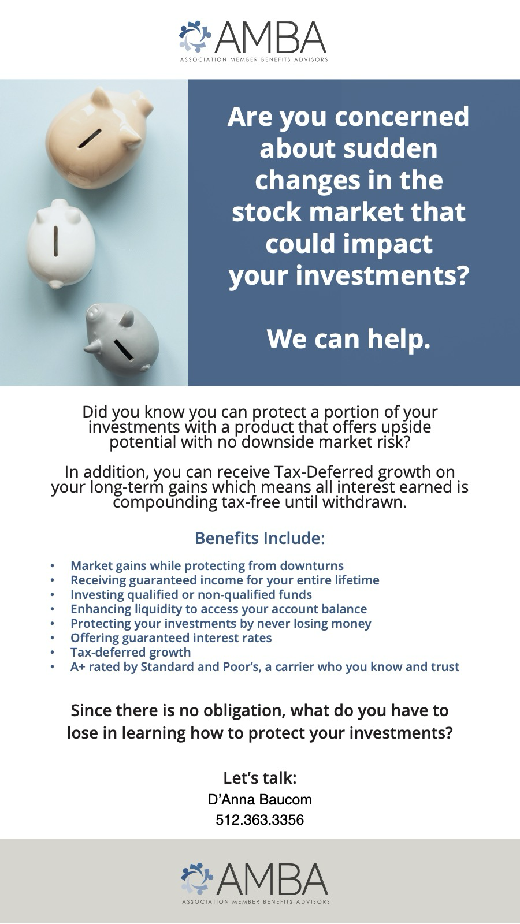

Slide 23
Assest Protection Plan
Your nest egg and financial security is always our priority, I wanted to share an exciting opportunity that could enhance your retirement savings while safeguarding your principal.
We have a financial solution designed to offer you the best of both worlds: the potential for growth and the security of knowing you won’t lose money due to market downturns. You have worked hard in the public sector to build your portfolio and now in retirement we want to protect your nest egg without paying fees.
Here’s what makes the Fixed Index Annuity an attractive option:
• Growth Potential: Your savings could grow based on the performance of a market index, such as the S&P 500, without being directly invested in the market. This means you can benefit from potential market gains.
• Principal Protection: Unlike direct investments in the stock market, a Fixed Index Annuity ensures that your principal is protected from market losses. No matter how the market performs, your initial investment remains secure.
• Tax-Deferred Growth: Your money grows tax-deferred, meaning you won’t pay taxes on the interest earned until you start receiving payments, allowing your savings to compound more effectively.
• Flexibility and Control: With a variety of options available, you can choose the annuity that best fits your financial goals, whether you’re looking for guaranteed income in retirement or simply want to grow your savings with minimal risk.
I believe this could be a valuable addition to your financial strategy, especially in today’s uncertain market environment. We welcome the opportunity to present you with an illustration to review and discuss how this could fit into your overall retirement plan. This will show how you can earn in the future.

Slide 24
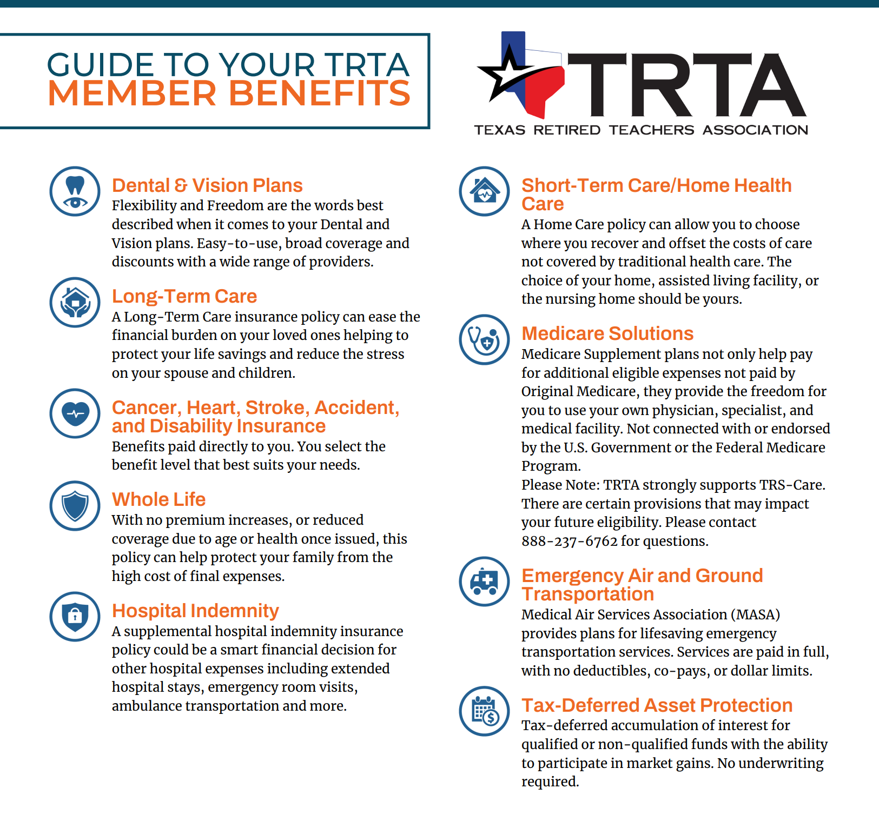

Find out the details – schedule a review
Personal URL QR Code
D’Anna Bauco
512.636.3356
danna.baucom@getamba.com

